Slide 1
Workshop 2

Slide 2
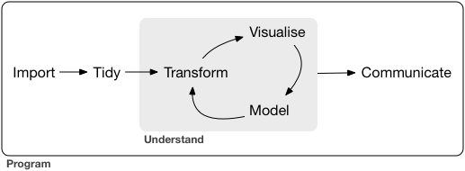
Where are we?

Slide 3
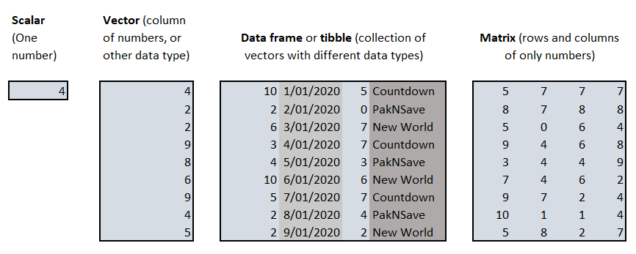
Data in R

Slide 4
Data in R

Slide 5
Data in R

Slide 6
Data in R

Slide 7
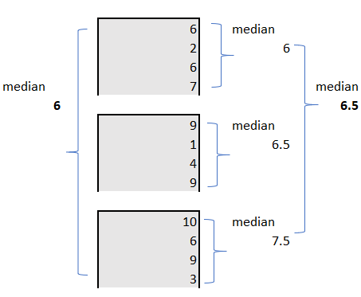
Does grouping affect statistics?

Slide 8
Does grouping affect statistics?

Slide 9
Does grouping affect statistics?

Slide 10
Homework
Finish Chapter 5 (Ex 5.6.7)
Do exercises 6.3 from R4DS
And of course 1 to 6!

